Slide 1
Student Digital Portfolio
Student Name: Ashika Parveen Register No & NMID: 24134131802522001 & asanm41341324214001 Department: Computer Science College/University: Deen College of Arts and Science / Annamalai University
asanm41341324214001
STUDENT NAME: M.Ashika parveen
REGISTER NO AND NMID: 24134131802522001 anasanm41341324214001
COLLEGE/ UNIVERSITY:Deen college of arts and science/Annamalai university

Slide 2
PROJECT TITLE
“Smart Student Management System”
“Smart Student Management System”

Slide 3


AGENDA
Problem Statement
Project Overview
End Users
Tools and Technologies
Portfolio design and Layout
Features and Functionality
Results and Screenshots
Conclusion
Github Link
3/21/2024 Annual Review

Slide 4

PROBLEM STATEMENT
Colleges and schools face challenges in managing student data, attendance, and performance manually. Traditional methods are time-consuming, error-prone, and lack real-time accessibility. There is a need for a digital system to store, manage, and retrieve student details efficiently.

Slide 5

PROJECT OVERVIEW
The Smart Student Management System is a web-based application designed to store and manage student details such as attendance, grades, courses, and personal information. It provides an easy interface for faculty to manage records and for students to access their profiles and academic reports anytime.

Slide 6

WHO ARE THE END USERS?
Students – to check their attendance, marks, and profile. Faculty/Teachers – to update and manage student data. College Administration – for overall monitoring. Parents – (optional) to view student progress reports.

Slide 7

TOOLS AND TECHNIQUES
Frontend: HTML, CSS, JavaScript, Bootstrap Backend: Python (Django) / Node.js Database: MySQL Version Control: Git & GitHub Design Tools: Figma (for UI design)

Slide 8
POTFOLIO DESIGN AND LAYOUT
Homepage – welcoming dashboard. Login/Signup – separate panels for students and faculty. Student Profile – personal details, attendance, grades. Admin Panel – manage subjects, attendance, reports. Responsive Layout – works on mobile & desktop.
8

Slide 9
FEATURES AND FUNCTIONALITY
Profile Section – Personal details, academic info. Projects Showcase – With description, tools used, screenshots, GitHub links. Certifications – Upload and display certificates. Skills Highlight – Technical and soft skills. Download Resume option. Search/Filter for recruiters

Slide 10
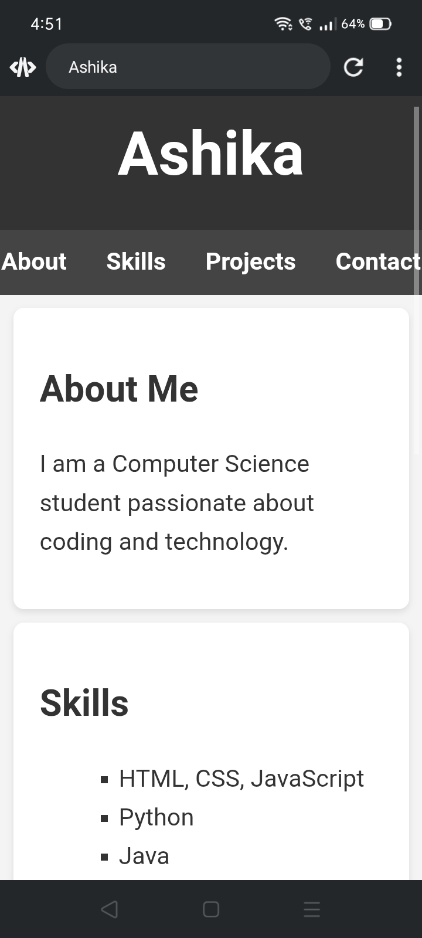
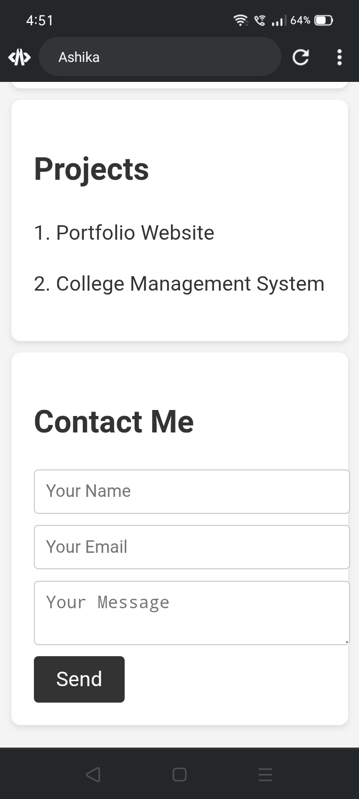

RESULTS AND SCREENSHOTS
3/21/2024 Annual Review
10

Slide 11
CONCLUSION
The Smart Student Management System makes student data management faster, more reliable, and accessible. It reduces paperwork, saves time, and provides transparency between students, teachers, and administration.
11

Slide 12
GitHub link:
https://github.com/7777777ashi/Ashika-TNSDC-FWD-DP.git

